Slide 1
Reconstruction of η → π⁰ γ γ Decays using FCAL Island Algorithm
Somov, Jefferson Lab
April 27, 2017
<number>

Slide 2
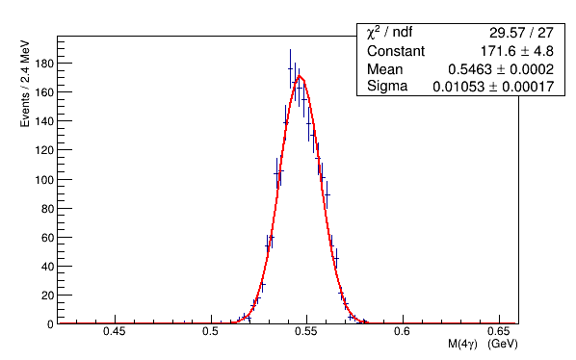
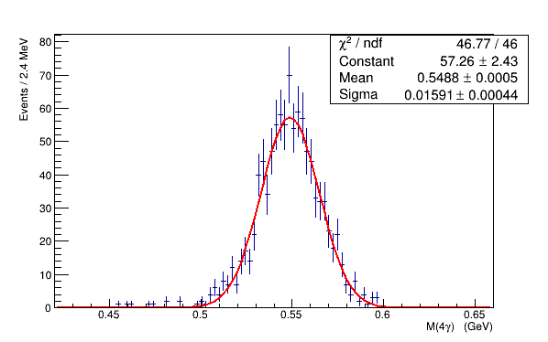
4 γ Invariant Mass
PWO₄ insert size: 1 m x 1 m
hole size: 2 x 2 cells
| X,Y | clust > 4 cm
inner most ring will be shielded
N pwo = 4
Number of clusters in PWO₄ calorimeter | Mass resolution (MeV)
N _{PWO} = 1 | 15.6
N _{PWO} = 2 | 15.0
N _{PWO} = 3 | 13.3
N _{PWO} = 4 | 10.5
N _{PWO} > 0 | 13.8
N pwo = 1
Select η candidates requiring Δ m = ± 2.2 σ
<number>

Slide 3
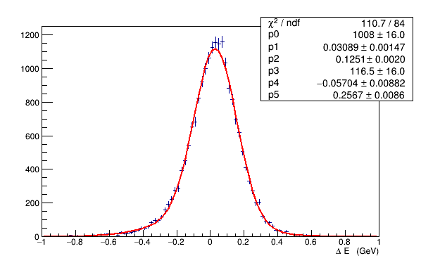
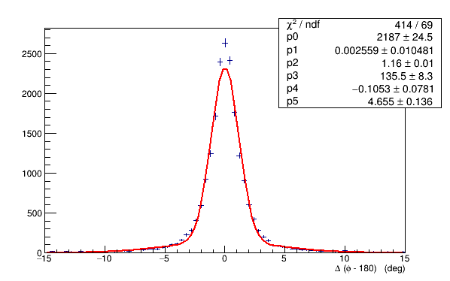
Energy and Angle Resolutions
Δ E
Δ ϕ
σ (E) ~ 120 MeV
σ (ϕ) ~ 1.2 deg
Event selection: Δ E < 0.4 GeV, Δ ϕ < 4 ° , Elast > 0.95
Typical reconstruction efficiencies:
(1) 4 clusters (proton not required) – 70 .4 %
(2) 4 clusters (proton not required), not overlapped (island cluster type 0 or 100) - 63.3 %
(3) 4 clusters + reconstructed proton – 37 %
(4) the same as in (3), require Δ E, Δ E, Δ m_{4γ} , ... – 30 %
(5) the same as in (4), require clusters to be in FCAL - 20%
(6) use E^{MIN} _{γ} > E_{THR} - 16 %
<number>

Slide 4
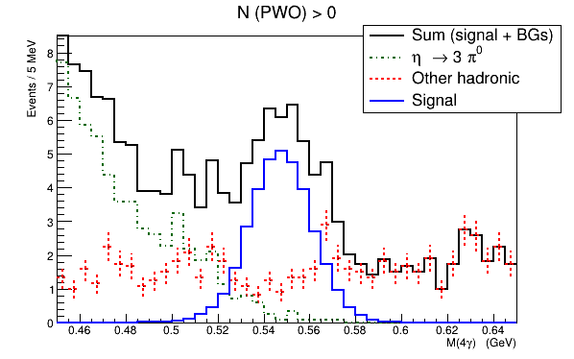
The Yield: Signal and Backgrounds
All photons
reconstructed
in FCAL
S / B ~ 1.5
Invariant mass M _{4γ} for the hybrid calorimeter including the signal and
η→3π⁰ + other hadronic backgrounds
Rates are normalized to 1 beam day
Beam conditions correspond to the GlueX high –lumi run
Eta mesons are reconstructed in the range 8.4 – 11.7 GeV
(flux of collimated photons corresponds to 10.4 ⋅ 10⁷ γ/sec)
<number>

Slide 5
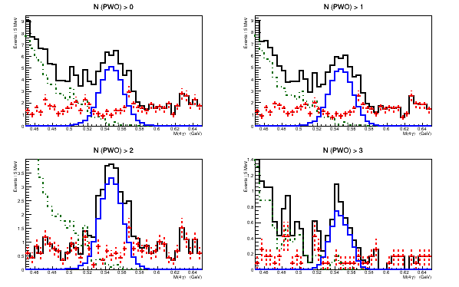
The Yield: Signal and Backgrounds
N clust in PWO₄ insert | Eff (%) | S/B
N _{PWO} > 0 | 15.5 | 1.5
N _{PWO} > 1 | 14.8 | 1.6
N _{PWO} > 2 | 9.5 | 2.2
N _{PWO} > 3 | 1.8 | 3.3
Relatively good S/B ration for N _{PWO} > 2, the yield is close to what we had in the
proposal
<number>

