Slide 1
Early Progress on Reaction Simulations – Photon/Neutron Separation on BCAL
Tolga Erbora
14 June 2018

Slide 2
Method
Used genr8 to create 10,000 events of pi0s for the reaction $γp→pπ^{0}→pγγ$
Used genr8 to create10,000 events for the reaction $γp→π^{+}n$
Used hd_root to generate ROOT trees
Used Dselector to cut what was outside of the 11-126 degree polar angle range
… and then analyze what’s left for now

Slide 3
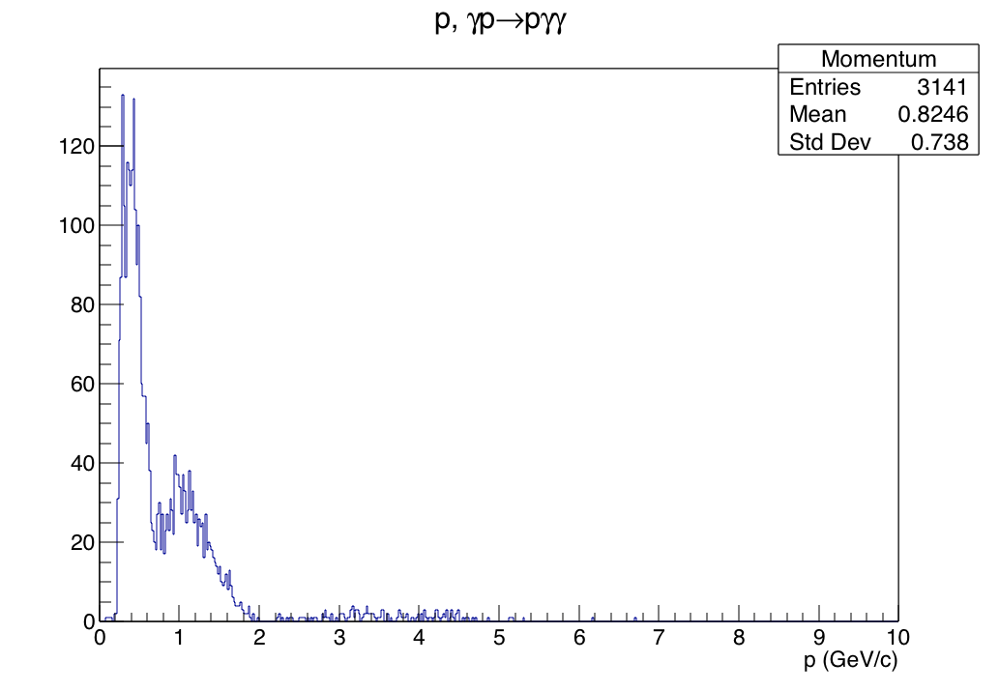
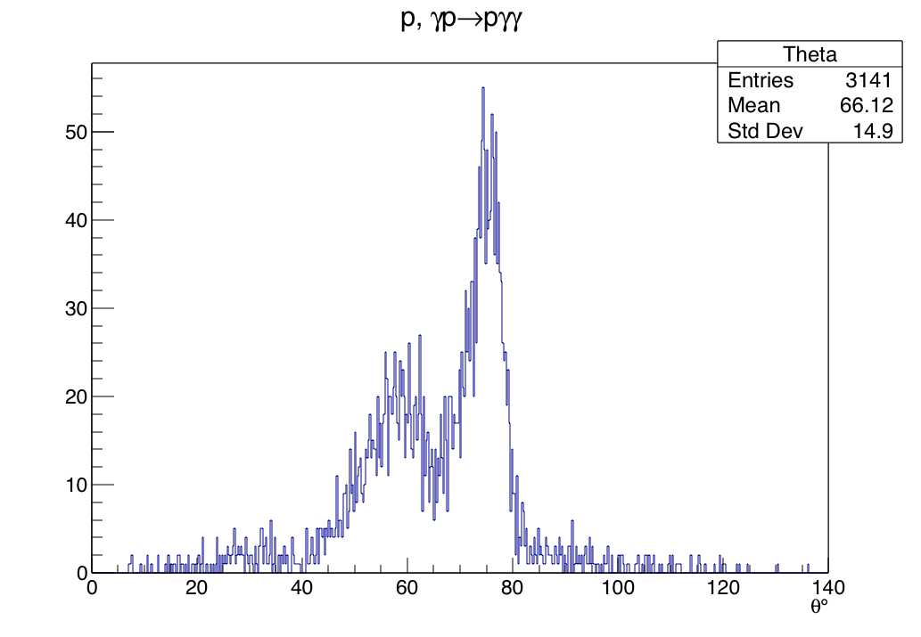
$$γp→pγγ$$
Proton momentum and theta, before cut

Slide 4
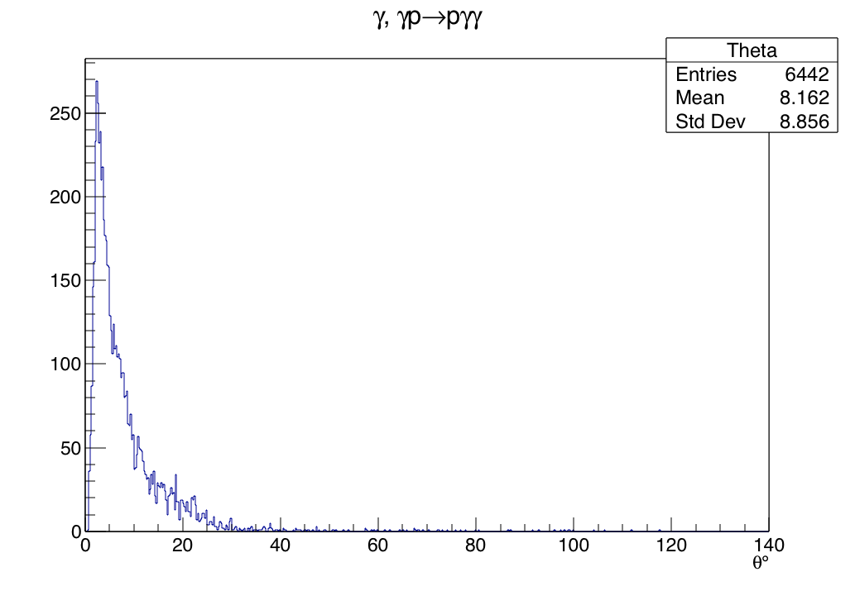
$$γp→pγγ$$

Slide 5
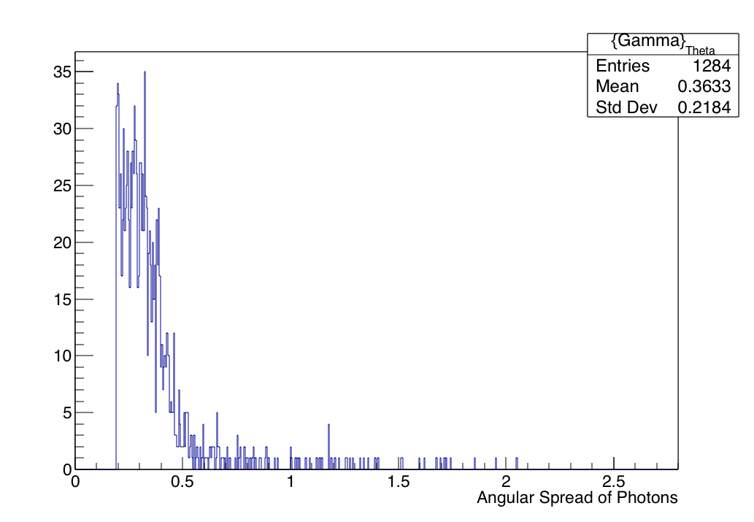
After the angle cut (11-126 deg)

Slide 6
PvsTheta Plot – after cut

Slide 7
Pi0 Mass verification

Slide 8
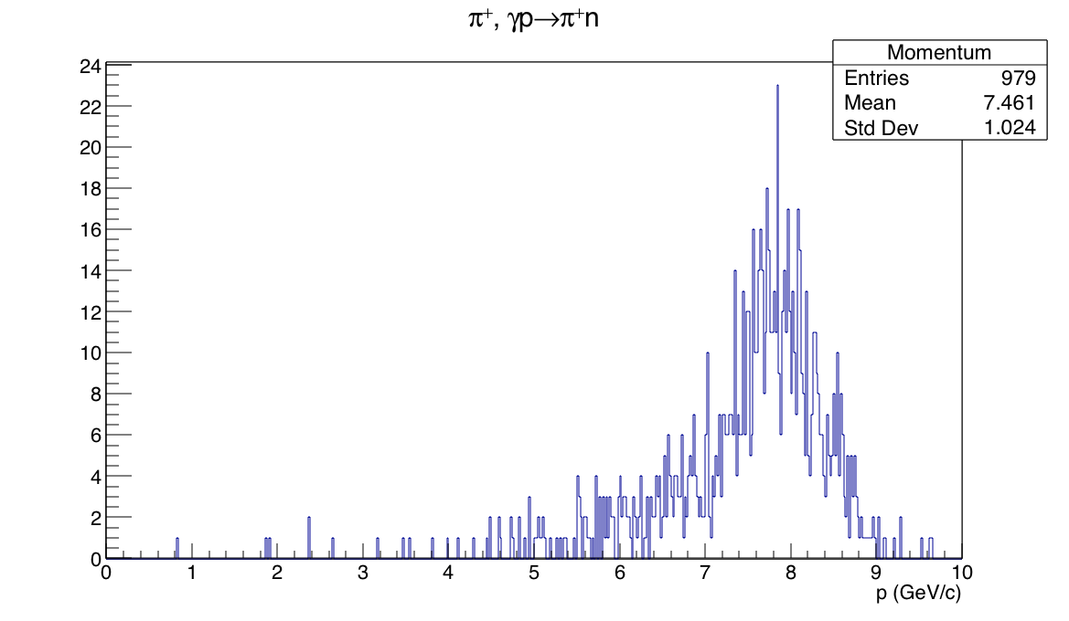
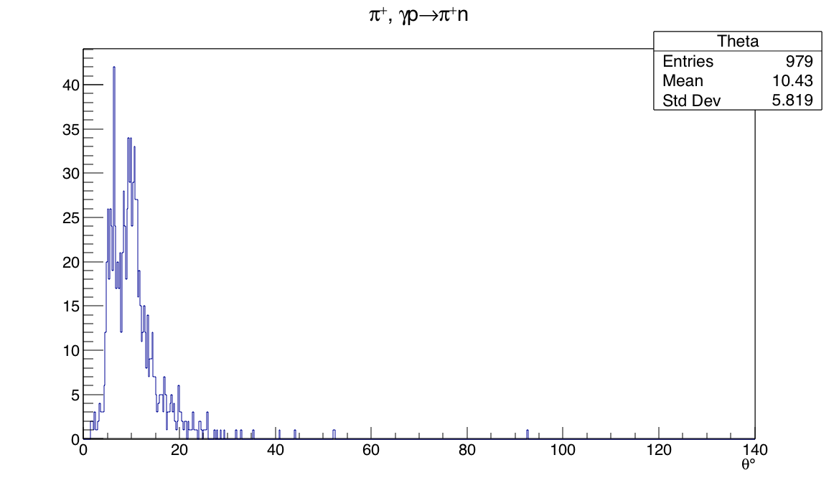
$$γp→π^{+}n$$
Initial problem with genr8 – not enough events
Did experiment with different t-slope values, this set of data reflects strongly off that for a choice of t=0.5
Piplus P and Theta:

Slide 9
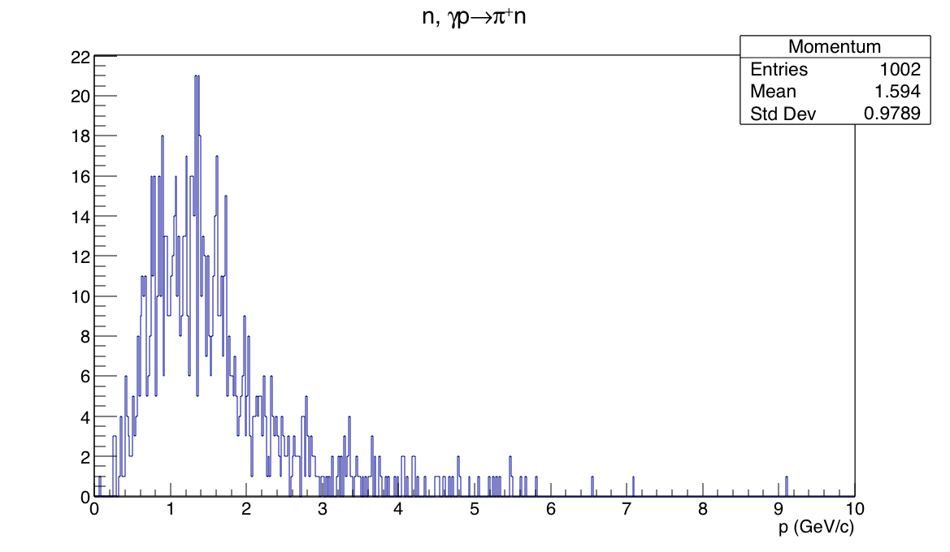
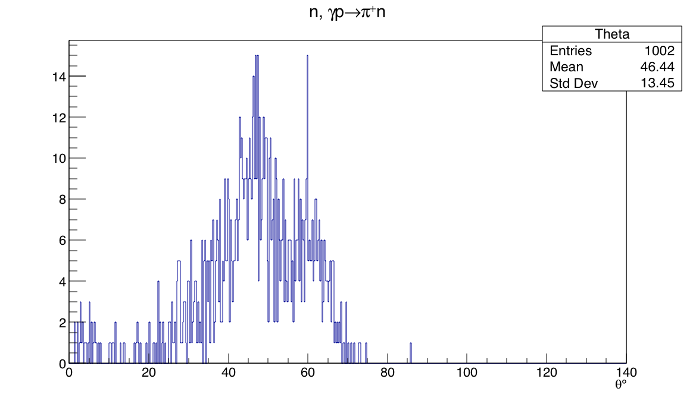
$$γp→π^{+}n$$
Neutron, before BCAL cut

Slide 10
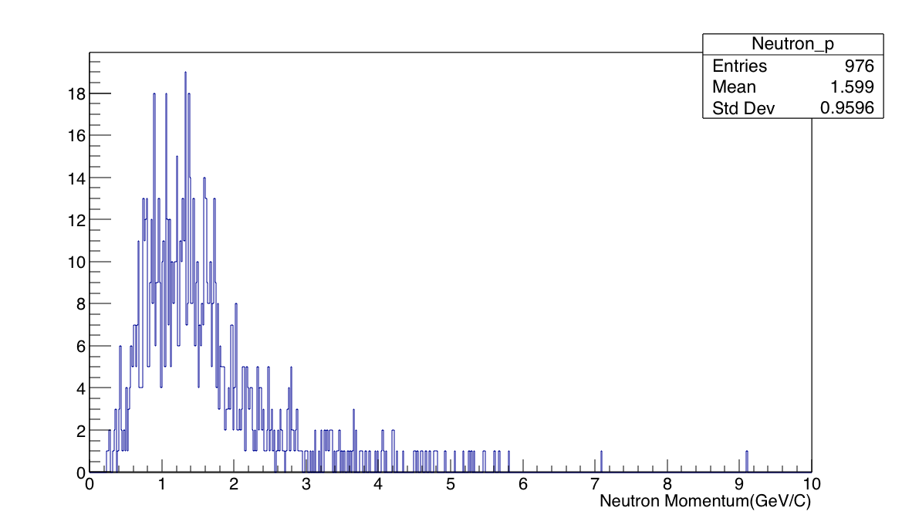
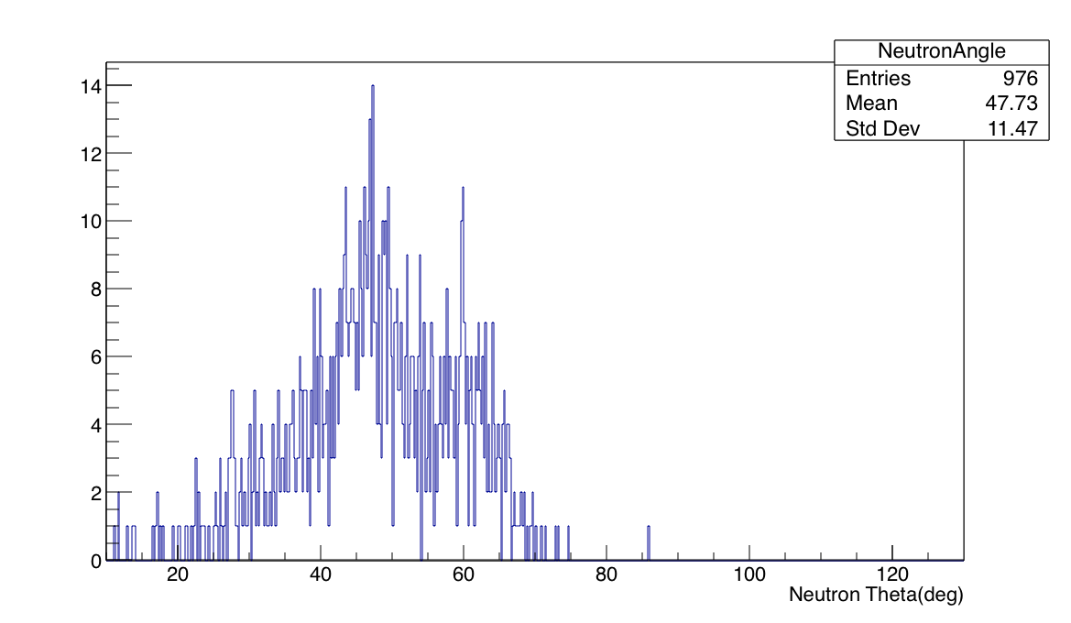
$$γp→π^{+}n$$
Neutron, after BCAL cut.

Slide 11
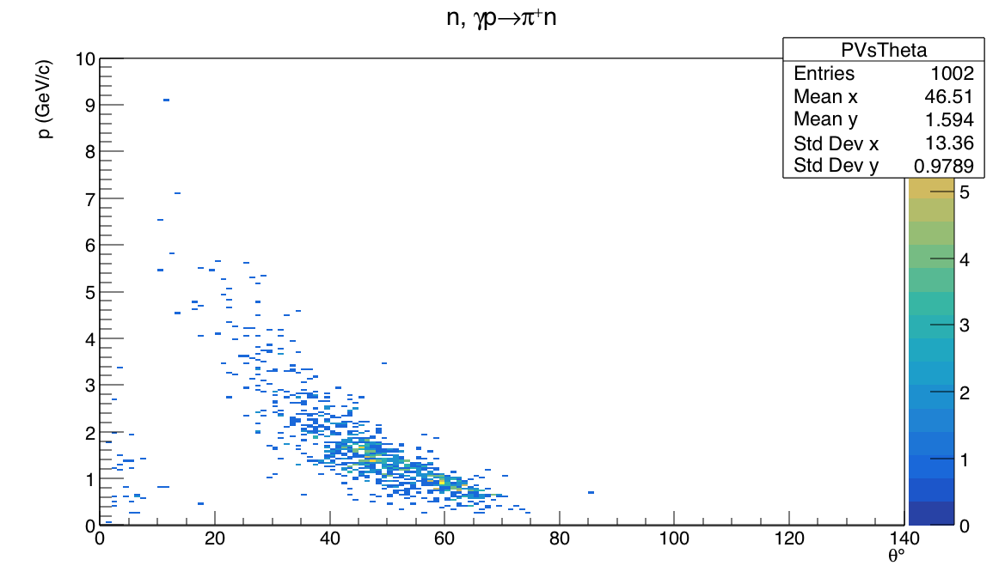
$$γp→π^{+}n$$
P vs theta (before, but not a large difference between before and after)

