Slide 1
Experimental Requirements
Objectives:
Measure production of vector mesons (ρ, ω,φ) on nuclei in the energy range
5 < E _{γ} < 12 GeV Experimental challenge
- Large rate of coincidential hits in tagger
- Background (neutron) in the experimental hall

Slide 2
Experimental Requirements
Tagger Rate
Beam current 10 nA (about 220 times smaller that the nominal GlueX current of 2.2 μA)
Flux of uncollimated photons 10⁸ γ/sec (1.2 MeV < E_{γ} < 12 GeV)
Coincidential rate in the tagger in the energy range 4.5 – 6.5 GeV is about 3 %
(in a 8 ns time window).
Flux of collimated and tagged photons:
2.3 x 10⁵ γ/sec (5 GeV < E_{γ} < 6 GeV)
4.1 x 10⁵ γ/sec (8 GeV < E_{γ} < 9 GeV)
Hodoscope sampling fraction in the range 5 – 6 GeV about 0.3
Microscope can bepotentially moved to the region around 6 GeV

Slide 3
Experimental Requirements
Omega yield:
Thickness of nuclei targets – 7 % X₀ (400 μm Pb)
Production rate of omega mesons in incoherent process on a Pb target:
R = 7.8 ω/sec (5 GeV < E_{γ} < 6 GeV) 0.28 reconstructed ω /sec
R = 7.3 ω/sec (8 GeV < E_{γ} < 9 GeV)
Target | σ _{INCOH} (μb) |  | N _{REC} per day
 | 5 GeV | 9 GeV | 5 GeV | 9 GeV
Al | 31 | 19 | 15600 | 17600
Pb | 130 | 64 | 17300 | 16500

Slide 4
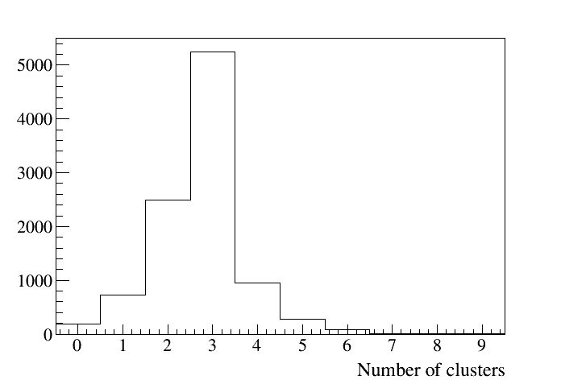
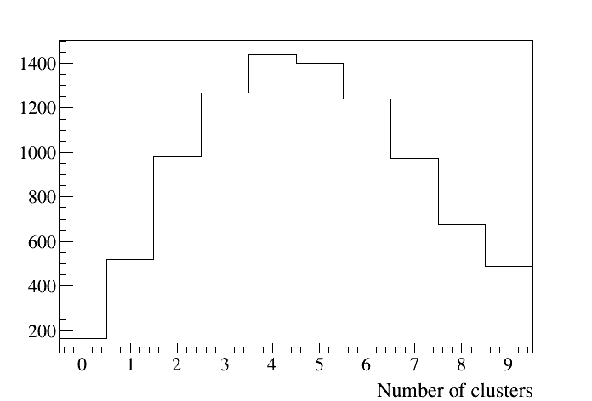
Reconstruction of ω → π⁰ γ
Total number of reconstructed clusters (clusters from tracks removed)
Signal
Pythia BG
Event selection – 3 clusters in BCAL and FCAL

Slide 5
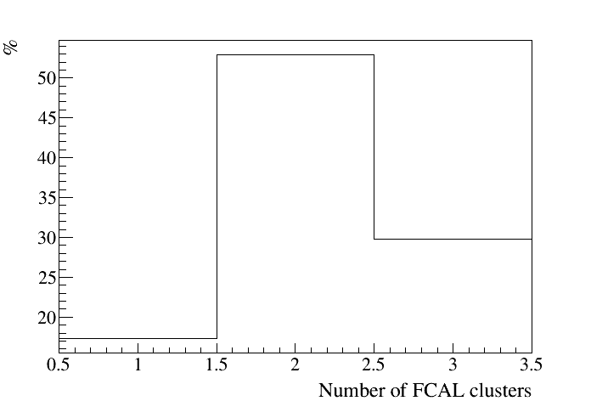
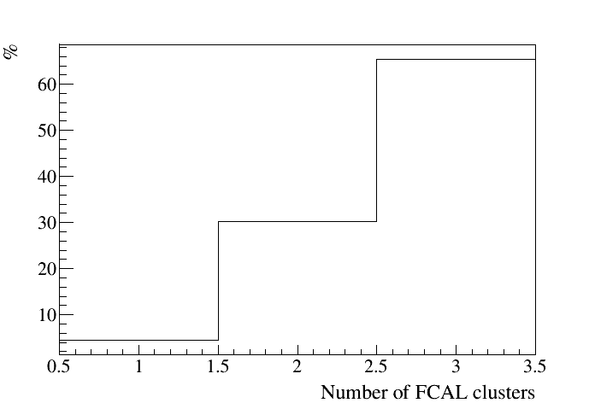
Reconstruction of ω → π⁰ γ
Number of clusters reconstructed in FCAL / BCAL for different beam energies
5 GeV < E_{γ} < 8 GeV
8 GeV < E_{γ} < 12 GeV
Reconstruction efficiency: 42 % ( 5 < E_{γ} < 8 GeV)
46 % ( 8 < E_{γ} < 12 GeV)

Slide 6
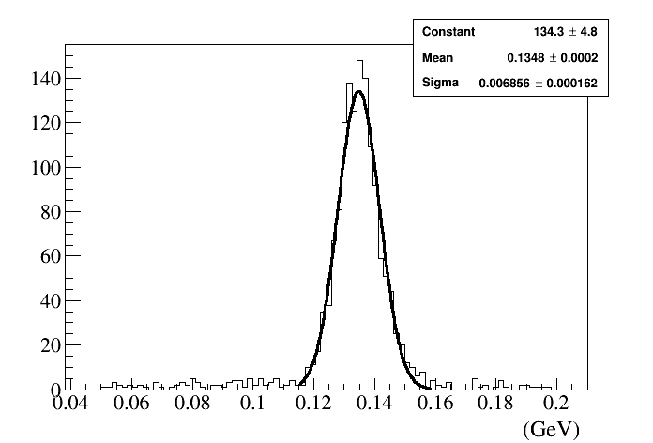
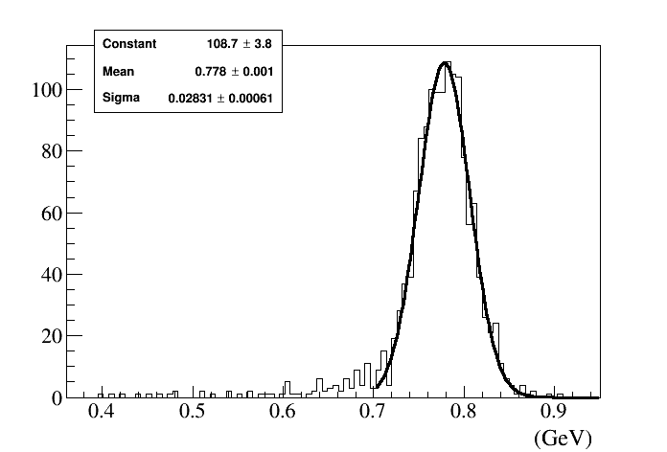
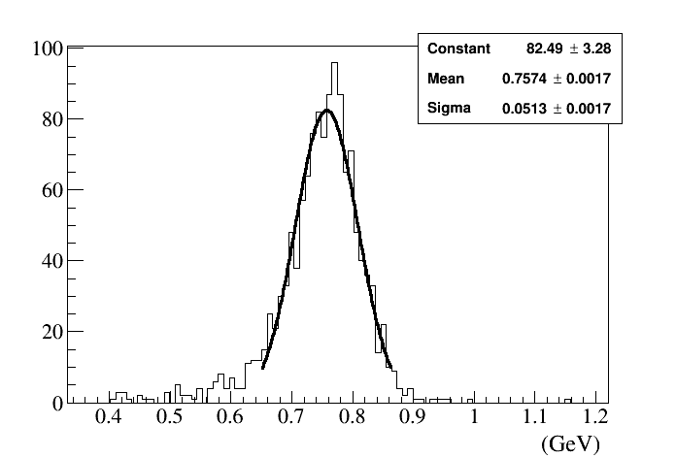
Reconstruction of ω → π⁰ γ
π⁰ invariant mas
σ (m) - 7 MeV (all FCAL) 8.7 MeV (FCAL and BCAL)
ω invariant mas
σ (m) - 28 MeV (all FCAL)

Slide 7
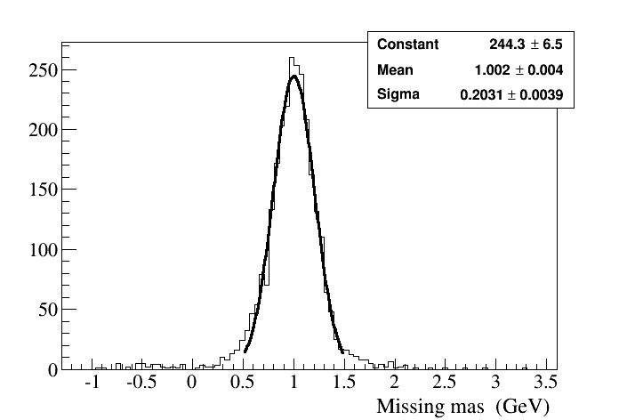
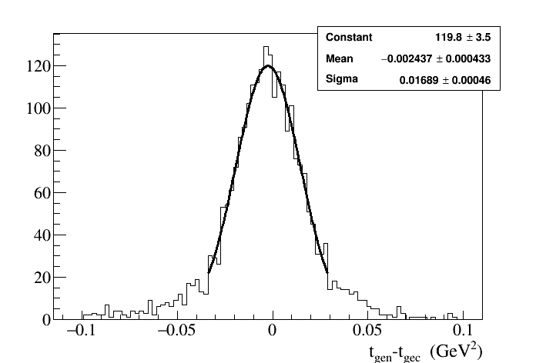
Reconstruction of ω → π⁰ γ
Missing mas
~ 200 MeV
Momentum transfer t
Δ t = 0.017 GeV²

Slide 8
Next Steps
Continue with the simulation of main decay channels for ρ, ω,
and φ on nucleon
Study EM and hadronic backrounds originating from nuclei targets

