Slide 1
Experimental Requirements
Objectives:
Measure production of vector mesons (ρ, ω,φ) on nuclei in the energy range
5 < E _{γ} < 12 GeV Experimental challenge
- Large rate of coincidential hits in tagger
- Background (neutron) in the experimental hall

Slide 2
Experimental Requirements
Tagger Rate
Beam current 10 nA (about 220 times smaller that the nominal GlueX current of 2.2 μA)
Flux of uncollimated photons 10⁸ γ/sec (1.2 MeV < E_{γ} < 12 GeV)
Coincidential rate in the tagger in the energy range 4.5 – 6.5 GeV is about 3 %
(in a 8 ns time window).
Flux of collimated and tagged photons:
2.3 x 10⁵ γ/sec (5 GeV < E_{γ} < 6 GeV)
4.1 x 10⁵ γ/sec (8 GeV < E_{γ} < 9 GeV)
Hodoscope sampling fraction in the range 5 – 6 GeV about 0.3
Microscope can bepotentially moved to the region around 6 GeV

Slide 3
Experimental Requirements
Omega yield:
Thickness of nuclei targets – 7 % X₀ (400 μm Pb)
Production rate of omega mesons in incoherent process on a Pb target:
R = 7.8 ω/sec (5 GeV < E_{γ} < 6 GeV) 0.28 reconstructed ω /sec
R = 7.3 ω/sec (8 GeV < E_{γ} < 9 GeV)
Target | σ _{INCOH} (μb) |  | N _{REC} per day
 | 5 GeV | 9 GeV | 5 GeV | 9 GeV
Al | 31 | 19 | 15600 | 17600
Pb | 130 | 64 | 17300 | 16500

Slide 4
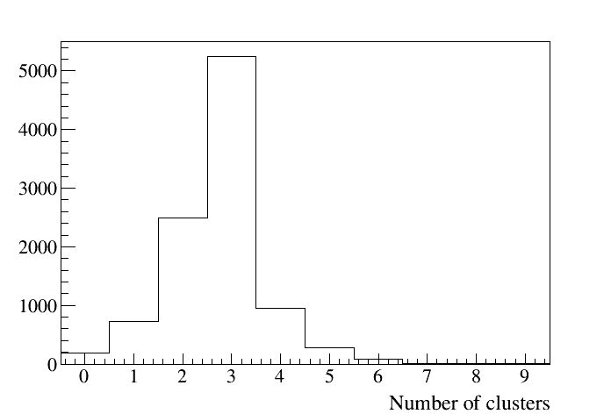
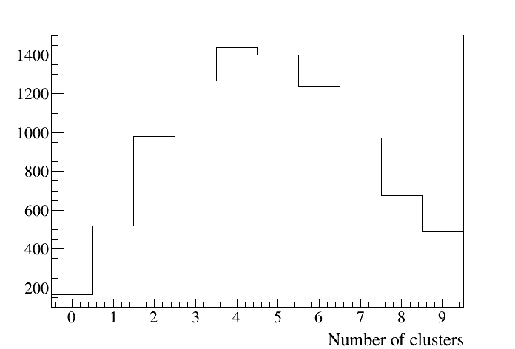
Reconstruction of ω → π⁰ γ
Total number of reconstructed clusters (clusters from tracks removed)
Signal
Pythia BG
Event selection – 3 clusters in BCAL and FCAL

Slide 5
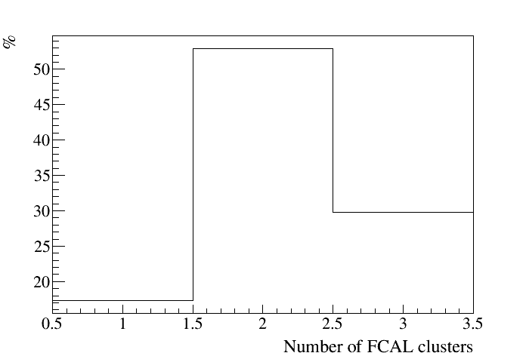
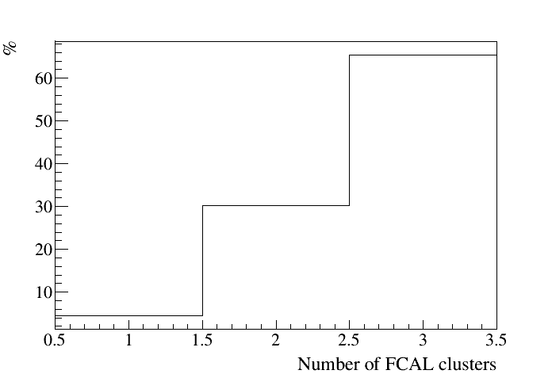
Reconstruction of ω → π⁰ γ
Number of clusters reconstructed in FCAL / BCAL for different beam energies
5 GeV < E_{γ} < 8 GeV
8 GeV < E_{γ} < 12 GeV
Reconstruction efficiency: 42 % ( 5 < E_{γ} < 8 GeV)
46 % ( 8 < E_{γ} < 12 GeV)

Slide 6
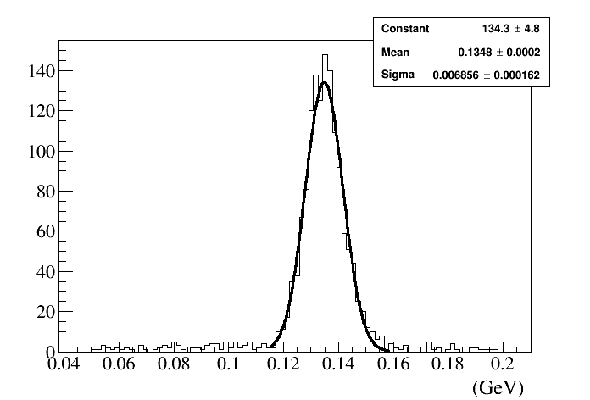
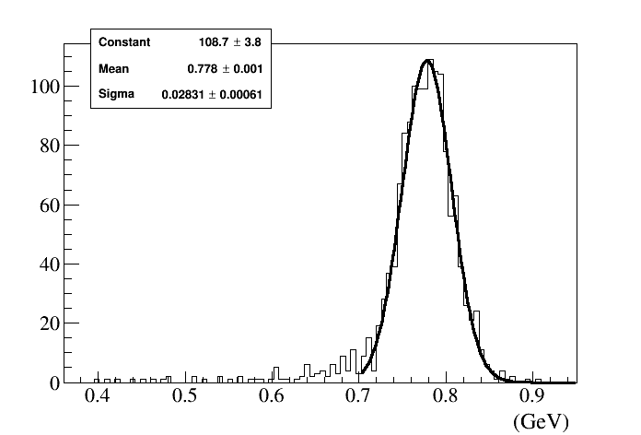
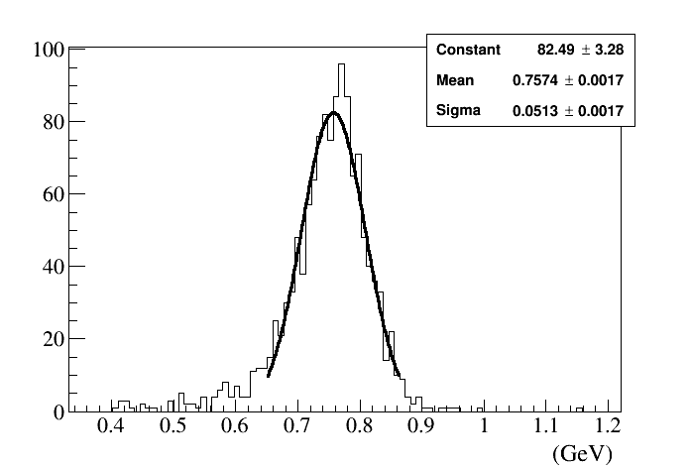
Reconstruction of ω → π⁰ γ
π⁰ invariant mas
σ (m) - 7 MeV (all FCAL) 8.7 MeV (FCAL and BCAL)
ω invariant mas
σ (m) - 28 MeV (all FCAL)

Slide 7
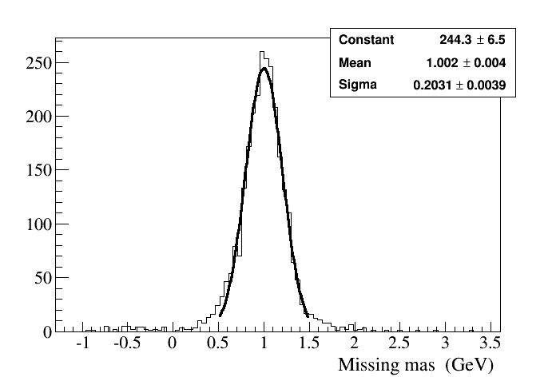
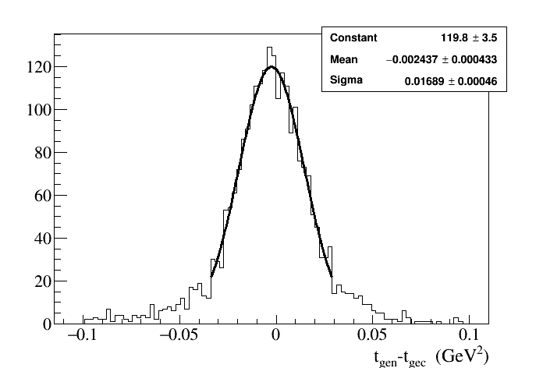
Reconstruction of ω → π⁰ γ
Missing mas
~ 200 MeV
Momentum transfer t
Δ t = 0.017 GeV²

Slide 8
Next Steps
Work on physics motivations for production of vector mesons on nuclei
(find people interested in this topic)
Continue with the simulation of main decay channels for ρ, ω,
and φ on nucleon
Study EM and hadronic backrounds originating from nuclear targets

