Slide 1
Chamber geometry
V=0
20 μm Au plated W sense wire
G
V_{F}
+V_{S}
50 μm Be-Cu field wire
S
V=0
Cathode planes, 1/32” aluminum plates
For the designs we’ve considered so far, S=2G, and V_{F}=0

Slide 2
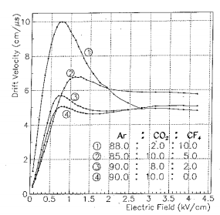
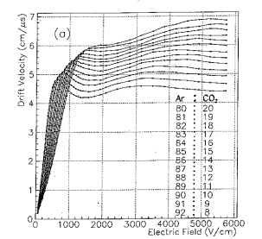
Choice of gas and electric field
Ar:CO₂:CF₄ 88:2:10
10 cm/μs @ .75 kV/cm
Ar:CO₂ 80:20
6 cm/μs @ 1.5 kV/cm
Zhao et al, Nucl. Inst. & Methods, 1993

Slide 3
Optimize size and voltage for Ar:CO₂ = 80:20
V
E = 1.5 kV/cm
G
S
E = 254 kV/cm
V
E = 254 kV/cm corresponds to a gas gain of 10⁵

Slide 4
Optimize size and voltage for Ar:CO₂:CF₄ = 88:2:10
V
E = .75 kV/cm
G
S
E = 254 kV/cm
V
E = 254 kV/cm corresponds to a gas gain of 10⁵

Slide 5
S cm | G cm | V_{S} | V_{F} | V cathode
2 | 1 | 1830 | 0 | 344
1 | 1 | 1880 | 0 | 530
1 | 1 | 2050 | 500 | 750

